Slide 1
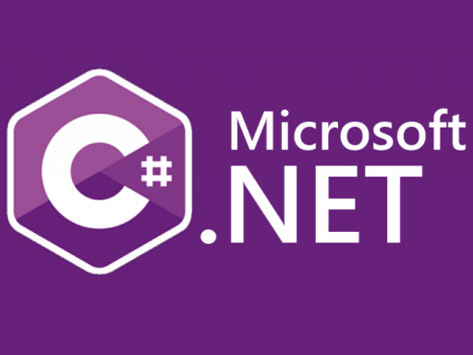

Modern C# and Programming Theory
Eric Williams
2025 Cenero Developer Summit
ewilliams@cenero.com

Slide 2
C# 8 -> 13 Language Features
Records
Immutable objects hold data
Tuples
Adoc data structures
Access Modifiers
New access modifiers
ValueTask<T>, IAsyncEnumerable<T>, and Task Extensions
Optimized Task for async methods with hotpaths
Pattern Matching
Expressive type checking
Collection Expressions
Compiler inferred collection declarations
Span<T>
Slice of memory typically used for string manipulation

Slide 3
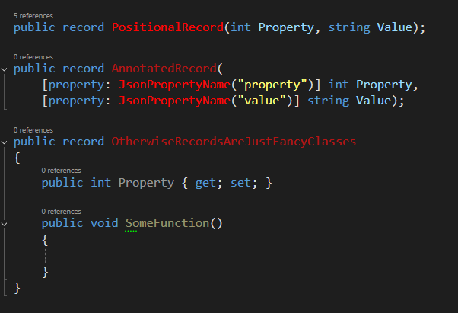
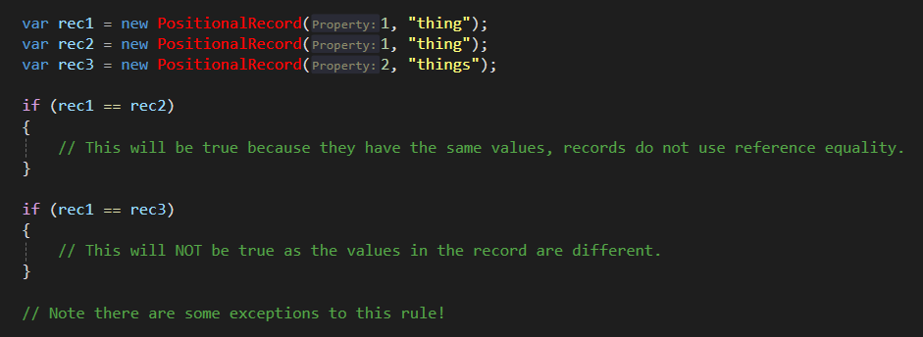
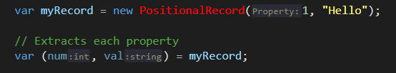
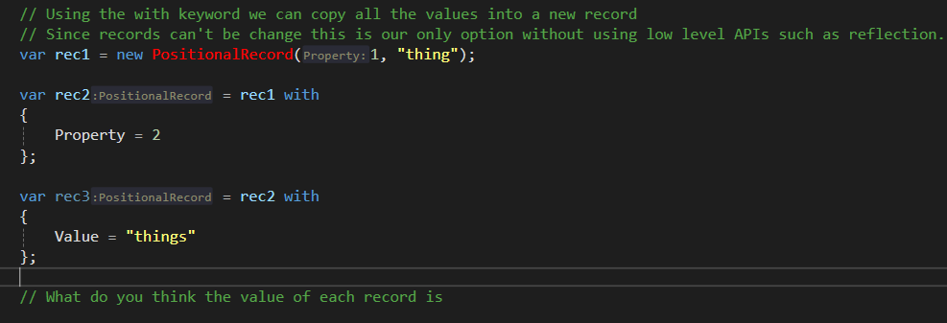
Records
Records in C# are an immutable data structure used to store values that can’t be changed.
Nope, records use value equality
Fancy Classes?
IMMUTABILITY
Records support destructuring OOTB
Records can’t be changed, but they can be copied

Slide 4
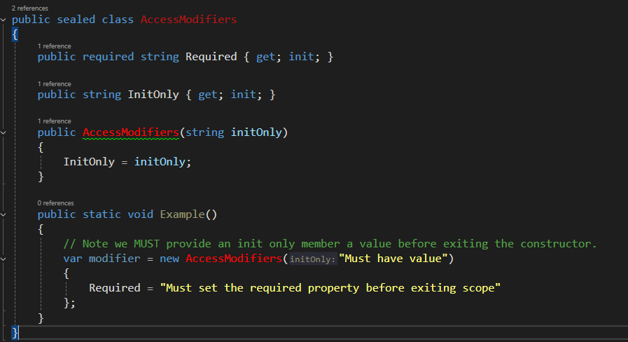
Access Modifiers
Modern C# adds two new access modifiers to support records and immutability
Init
Required
Forces initialization before exiting the constructor of a class.
Forces the consumer to define all required properties during object initialization.
IMMUTABILITY

Slide 5
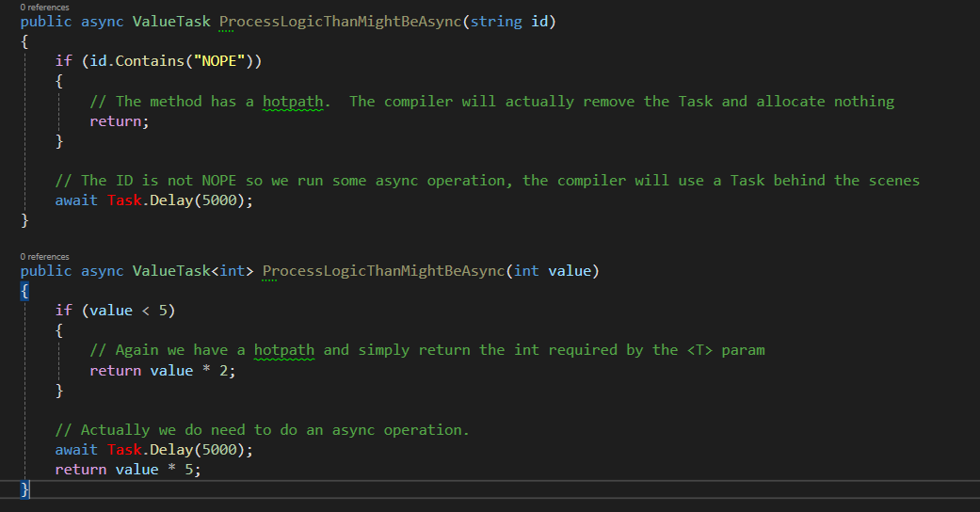
Value Task
A data structure that is either an async Task state machine or a value resolved synchronously.
ValueTask
An async Task or void Method
Hotpath
PERFORMANCE
ValueTask<TValue>
An async Task<T> or value T

Slide 6
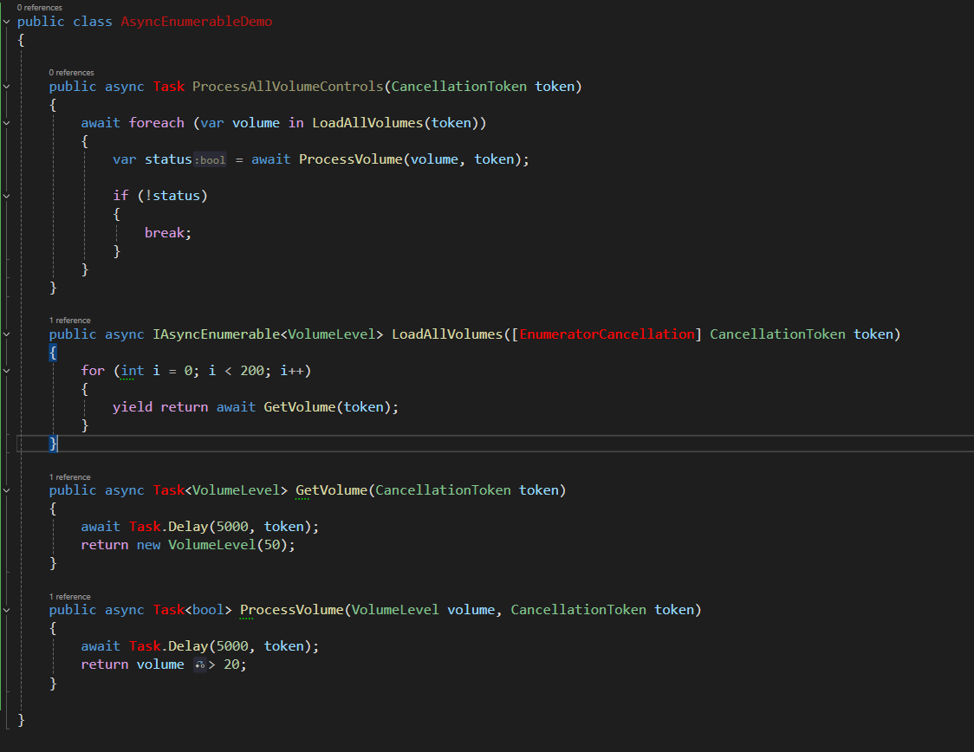
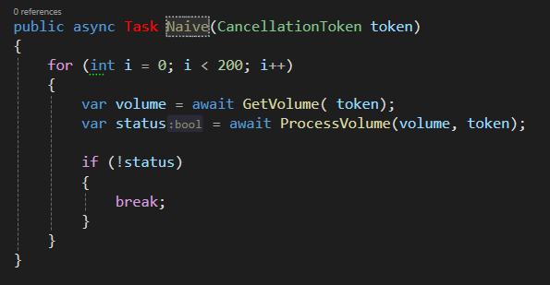
IAsyncEnumerable<T>
A Lazy iterator that support stream large amounts of data asynchronous and iteratively
IAsyncEnumerable with yield return FTW
What if I need to get several hundred volume levels?
PERFORMANCE
And worst what if I need to process the results of this new volume level?
We can now await the foreach loop and load items as they complete
Loop duh

Slide 7
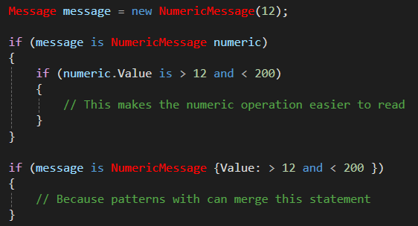
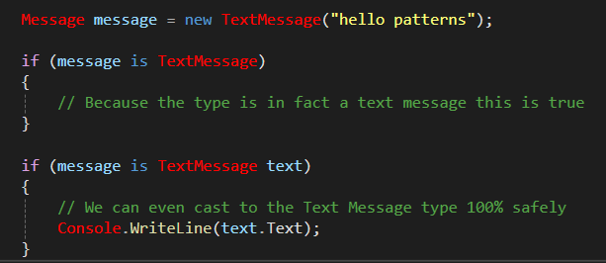
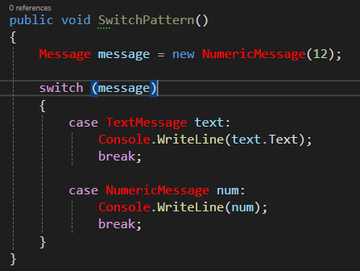
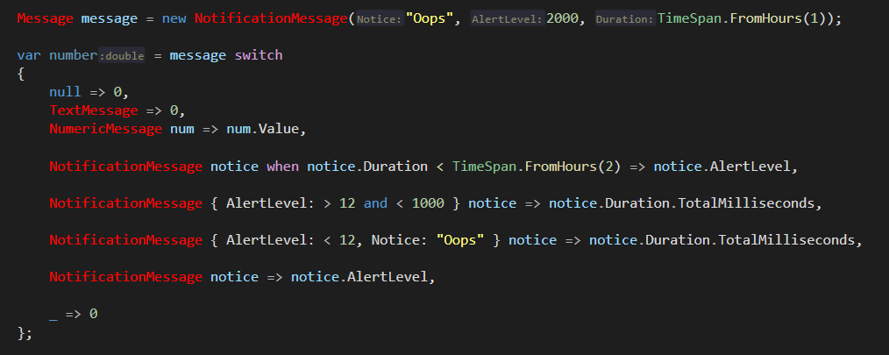
Pattern Matching
Pattern matching is a technique where you test an expression to determine if it has certain characteristics. C# pattern matching provides more concise syntax for testing expressions and taking action when an expression matches
But patters are more than just type checking. We can make comparisons as well!
It all starts with ‘is’ because things ‘are’
Capture the casted type
Again patters, this statement can be merged
And because we can ‘is’ we can also switch
And because of all of this we can use C# switch expressions combined with pattern matching to handle incredibly complex scenarios.
READABILITY & SAFE

Slide 8

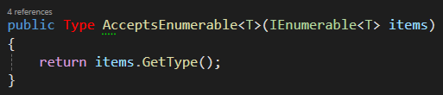

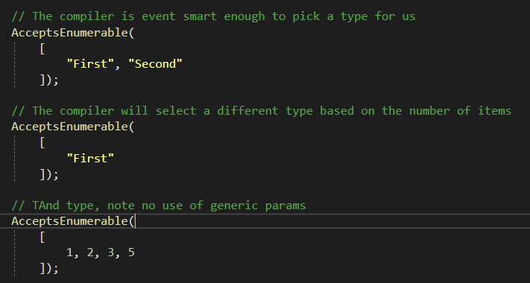
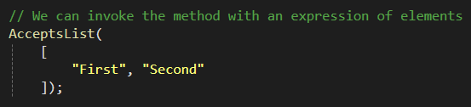
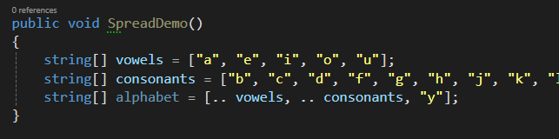
Collection Expressions
Compiler inferred collection declarations
Welp no, what about a more abstract method. Here we accept anything that can be enumerated
Here we have a function that accepts a list of strings.
What do you think the collection type will be?
We invoke the method and declare a new list
I don’t know and I don’t care, the dotnet team has ensured the time will be optimized based on how we use it
Wow, so basically its just shorter?
And we finally get the spread operator!
PERFORMANCE

Slide 9
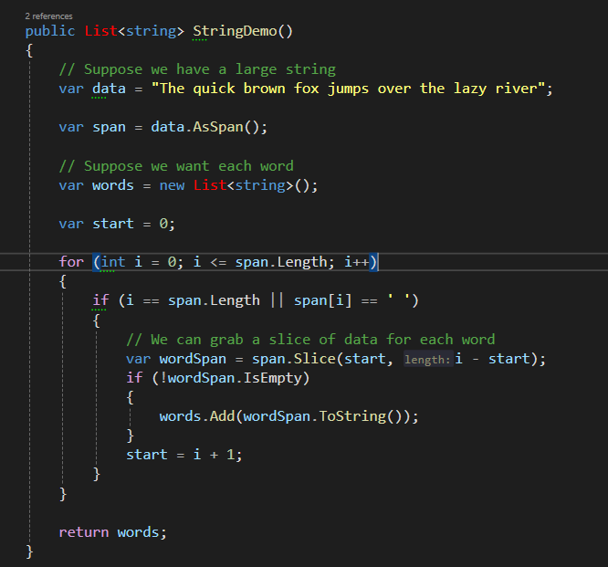
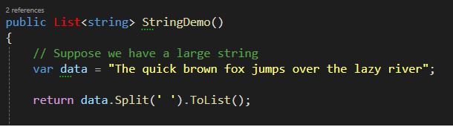

Span<T>
Provides a type-safe and memory-safe representation of a contiguous region of arbitrary memory.
Suppose we want each work from this phrase?
Now we can capture segments of this memory and process logic and parse data.
String.Split duh
Span.Slice()
We can capture a representation of this memory using AsSpan()
PERFORMANCE
Because spans are collections we can index and slice out data using range expressions

Slide 10
Additional Resources
Collection Expressions
Spans
Value Task
Pattern Matching
Additional Features
Interceptors
AOT Compilation
Primary Constructors
Default Lambda Parameters
Type Alias
Source Generators

Slide 11
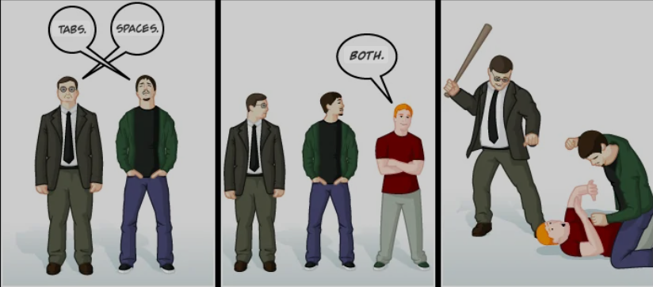
Programming Theory
Tabs vs Spaces
Why tabs are better
Tabs vs Spaces
Why tabs are better
Pure Functions
Functions that have no side effects
Type Definitions
Communicating with types
NOPE, IT DOES NOT MATTER
Functional Programming Paradigms
Exploring functional programming

Slide 12
Pure Functions
A pure function is a function that consistently produces the same output for the same input, without causing any side effects
You give me an int
And another int
I give you back an int
Assuming the first param and the second param are the same, the results will always be same
10 * 10 = 100
public int Multiply(int x, int y)
=> x * y;
Pure Functions

Slide 13
Impure Functions (Side Effects)
Impure functions are functions that include hidden inputs or outputs.
You give me an int
And I’ll evaluate a string
And give you back string
Every function you’ve ever written
public string FormatData(int value) => $"{Prefix}_{value}";
Here the public property Prefix could be mutated and the result can be different.
FormatData(12) == ???_12
Pure Functions

Slide 14
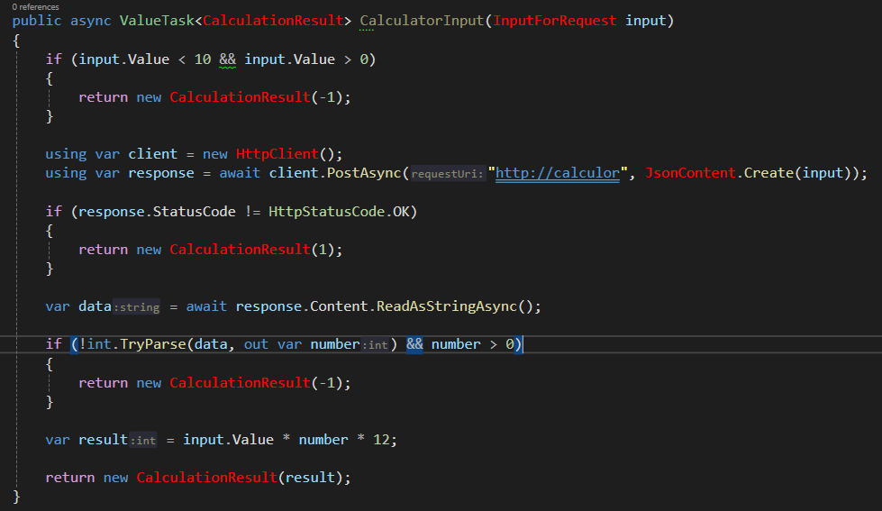
What are some functions with side-effects?
Hidden Inputs and Outputs
Database Statements
There could be a network error, SQL error, etc.
1 #10
2 #0
3 Client
4 Url
5 Serializer
Network Requests
The server could respond in an unexpected way
6 Response
Testable?
7 Data
So how can we solve this?
8 #12
Breaking down large tasks into smaller functions will help isolate issues, unit test, and keep functions pure.
Pure Functions

Slide 15
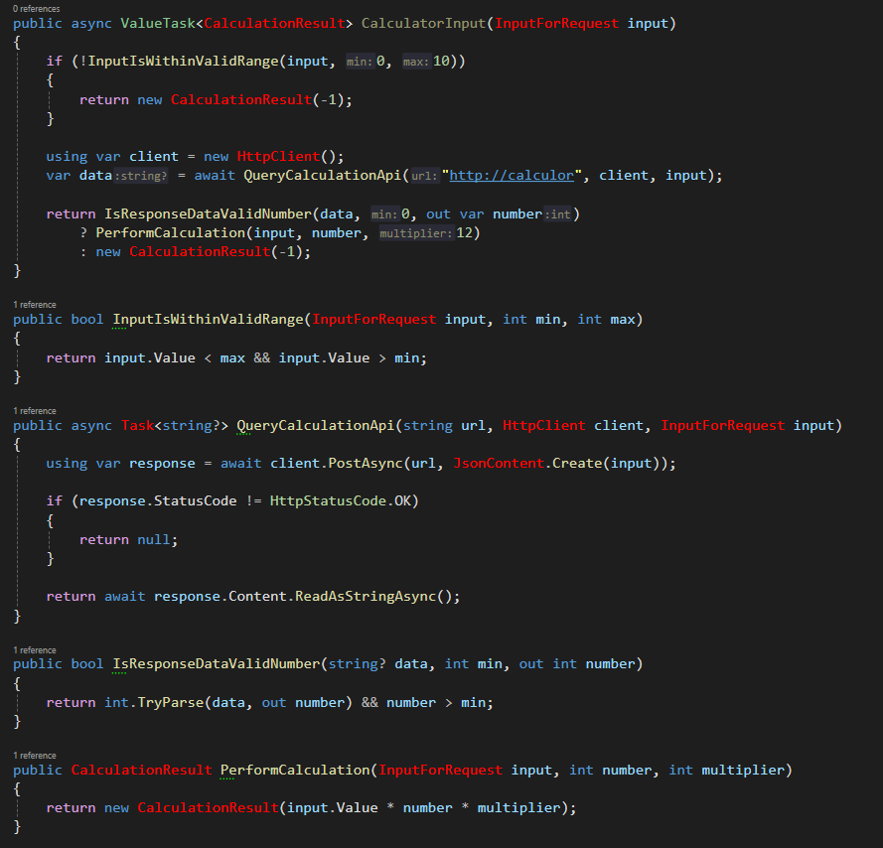
Extract smaller modular functions
Pure Functions

Slide 16
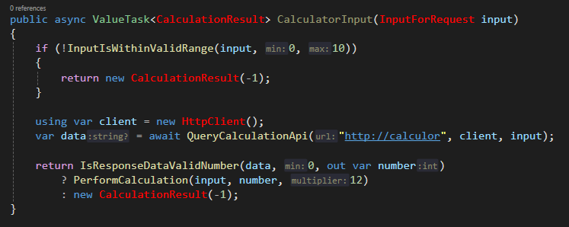
Compose these functions together
Pure Functions

Slide 17
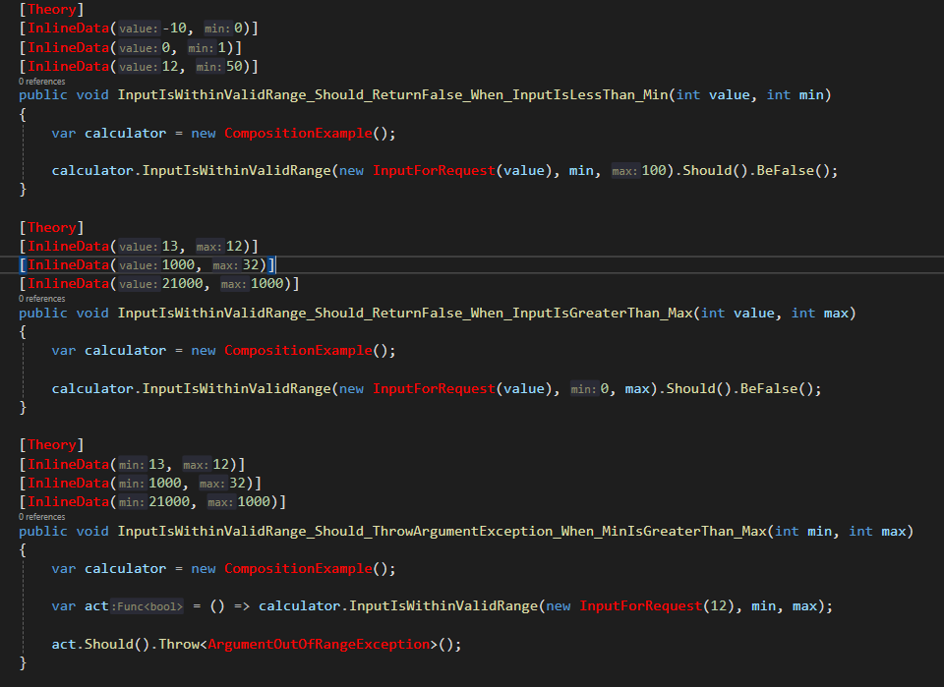
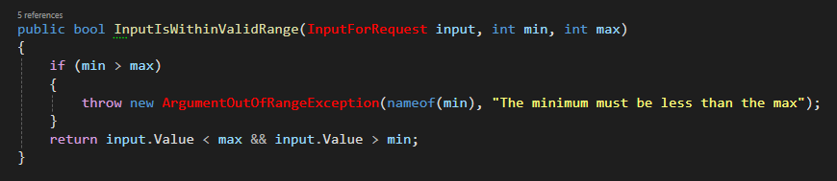
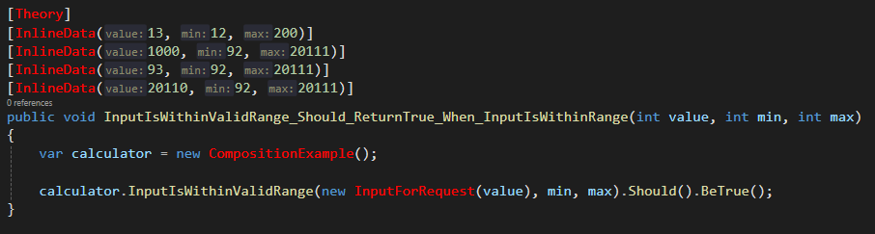
Smaller functions can now be tested!
I now have proof and don’t need to worry about this smaller portion of the code. I can focus my efforts on the business logic.
Pure Functions

Slide 18
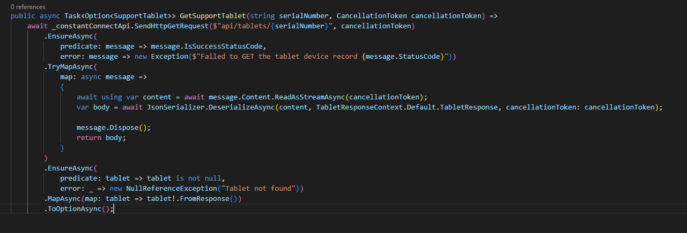
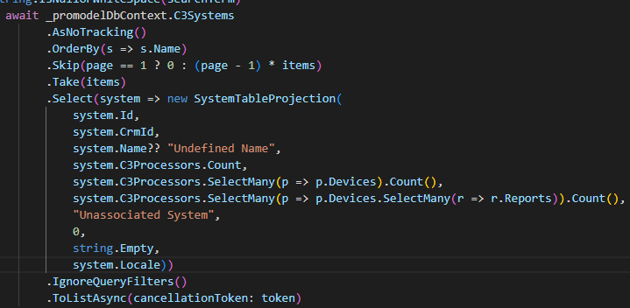
Taking Composition a Step Further
F(x) -> y
F(y) -> z
F(z) -> V
Pure Functions

Slide 19
Programming Theory
Pure Functions
Functions that have no side effects
Type Definitions
Communicating with types
Functional Programming Paradigms
Exploring functional programming

Slide 20
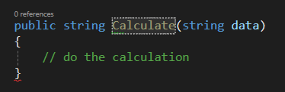
Type Definitions
Rember this function, we will come back to it at the end
Compilers?
LLMs?
What story does this function declaration tell?
SQL?
HTTP?
If you give me a string, I’ll “perform a calculation” and give you back a string.
What if I told you the entirety of computer science can be represented as
string -> string
Type Definitions

Slide 21
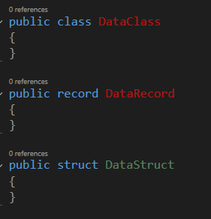
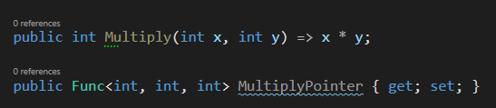

Type Definitions
In a static typed language, such as C#, we have several ways we can define types.
Methods and Delegates
Classes
Records
Interfaces
Structs
Type Definitions

Slide 22
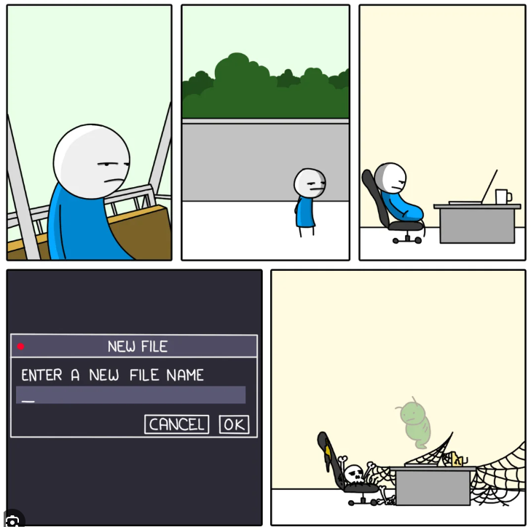
Naming Things is Hard!
Naming things is hard! In a static typed language, such as C#, the type system should be used to communicate information, intent, and help tell a story.
Type Definitions

Slide 23
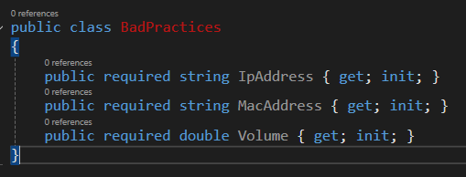
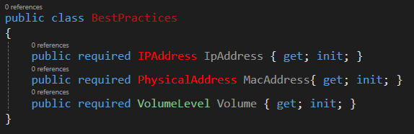
Primitive Obsession
Primitive obsession is the practice of using primitive types to represent more complex and meaningful concepts.
Primitive Properties
Strongly Typed
Note the property types are no longer primitive types.
Type Definitions

Slide 24
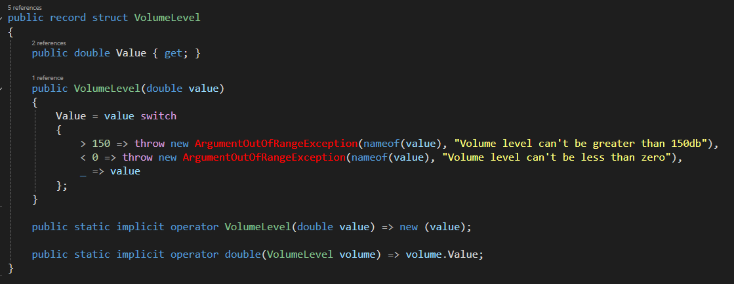
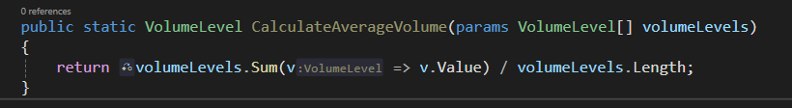
Value Objects
An object that stores a value and provides additional context. Here we are effectively wrapping a double and ensuring the VolumeLevel value object is NEVER greater than 150 or less than 0.
Value Objects
Utilizing the implicate operators we can still do “the Maths”
Type Definitions

Slide 25
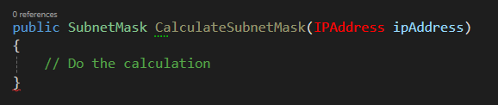
Conclusion
Remember me, what story do I tell now?
If you give me an IP Address I will calculate your IP Addresses subnet.
IPAddress -> SubnetMask
Type Definitions

Slide 26
Programming Theory
Pure Functions
Functions that have no side effects
Type Definitions
Communicating with types
Functional Programming Paradigms
Exploring functional programming

Slide 27
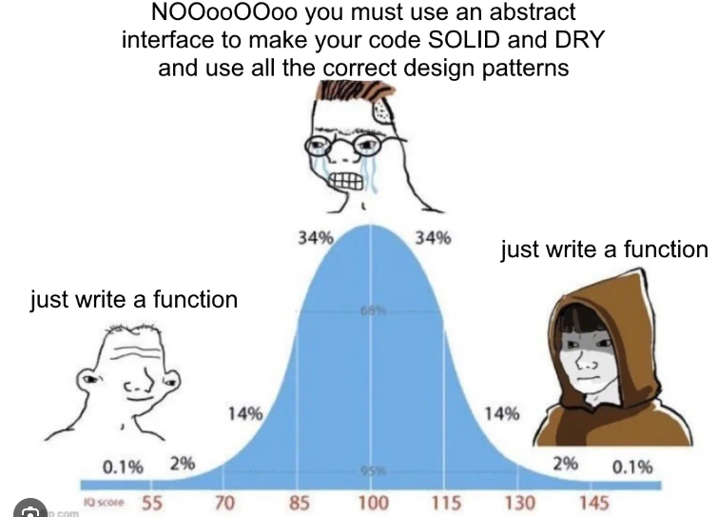
Functional Programming Paradigms
JIUST WRITE FUNCTIONS

Slide 28
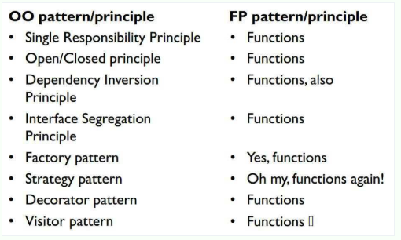
Functional Programming Paradigms
JIUST WRITE FUNCTIONS

Slide 29
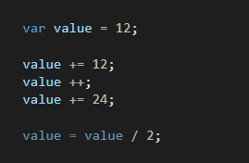
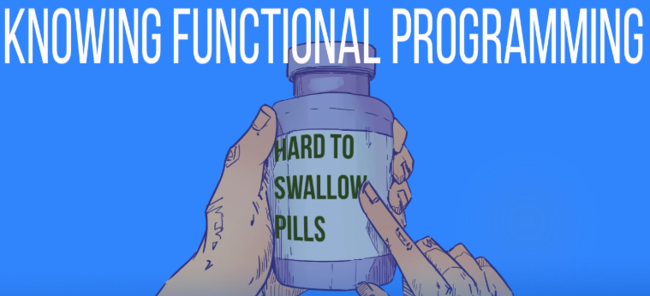
Functional Programming Paradigms
Immutability
Functional languages support NO mutations.
Literally none, I know it sounds crazy. How can you update state?
So How can I change Value?
Illegal
The hard to swallow pill is that you NEVER needed to, never was there a single situation where you had to change the state of a variable

Slide 30
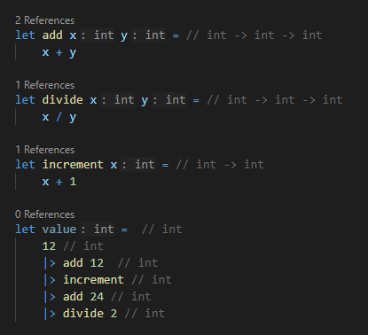
Functional Programming Paradigms
Don’t Mutate, return!
Given the last example here is how we would program this is F# using what? Functions
Each function takes and int and returns a new int
Int -> int -> int
All functional languages allow to chain functions together assuming the result of the function matches the input of next function.

Slide 31
Readability ?
What’s easier to read and understand?
You be the judge
🤷‍♂️

Slide 32
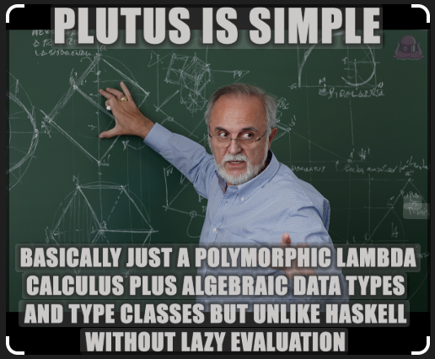
Algebraic Datatypes
Using the ‘Maths’
Algebraic Data Types (ADTs) are a way to structure data in functional programming, enabling the creation of composite data types by combining simpler types.
Bottom Line
Functional languages use a different type of Type system where types have a deterministic number or possible mutation. The compiler uses this to help you program.

Slide 33
Conclusion
As C# and dotnet continue to incorporate more and more functional paradigms into the language design, it’s becoming important for developers to understand these concepts.
Embracing functional paradigms can reduce bugs and, in some cases, make them entirely impossible, increase testability, and produce more readable code.

